Slide 1

What is Apache ?
Ли Ицзя, 30202
Notes:
主页：https://spark.apache.org/

Slide 2

Content
History of Spark
What is Spark?
Hadoop vs Spark
Components of Apache Spark
Spark Architecture
Application of Spark
Spark Use Case

Slide 3
History of Spark
2009
2010
2013
2014

Slide 4


What is Apache Spark?
Apache Spark™ is a multi-language engine for executing data engineering, data science, and machine learning on single-node machines or clusters.
Support various programming languages
Developers and data scientists incorporates Spark into their applications to rapidly query, analyze and transform data at scale

Slide 5

Hadoop vs Spark

Slide 6


Hadoop vs Spark

Slide 7

Spark Features
Fast processing
In-memory
computing
Flexible
Fault tolerance
Better analytics

Slide 8
Components of Apache Spark

Slide 9

Components of Apache Spark – Spark Core

Slide 10
Spark Core
Spark core is the base engine for large-scale parallel and distributed data processing
THE FIRST PART

Slide 11
Resilient Distributed Dataset (RDD)
Spark core is the base engine for large-scale parallel and distributed data processing
RDD
Transformation
Action

Slide 12
Components of Apache Spark – Spark SQL

Slide 13
Spark SQL
Spark SQL is …

Slide 14
Spark Streaming

Slide 15
Spark MLlib

Slide 16
GraphX

Slide 17
Spark Architecture
Apache Spark uses a master-slave architecture that consists of a driver, that runs on a master node, and multiple executors which run across the worker nodes in the clester

Slide 18
Spark Cluster Managers
1
2
3
4
04

Slide 19
Applications of Spark
Banking
E-commerce
Entertainment
单击此处添加本章节的简要内容。本模板精心设计，模板所有素材均可自由编辑替换移动。单击此处添加本章节的简要内容。
单击此处添加本章节的简要内容。本模板精心设计，模板所有素材均可自由编辑替换移动。单击此处添加本章节的简要内容。
单击此处添加本章节的简要内容。本模板精心设计，模板所有素材均可自由编辑替换移动。单击此处添加本章节的简要内容。

Slide 20
Spark Use Case

Slide 21
THANK YOU for your precious attention :)

Slide 22
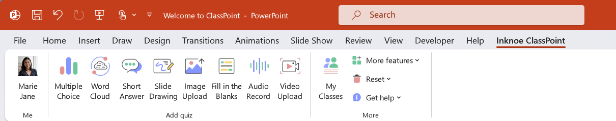

Hadoop vs Spark
ClassPoint is an interactive presentation add-in for PowerPoint that empowers every presenter to build strong live engagement with their audience.
ClassPoint Tab

Slide 23

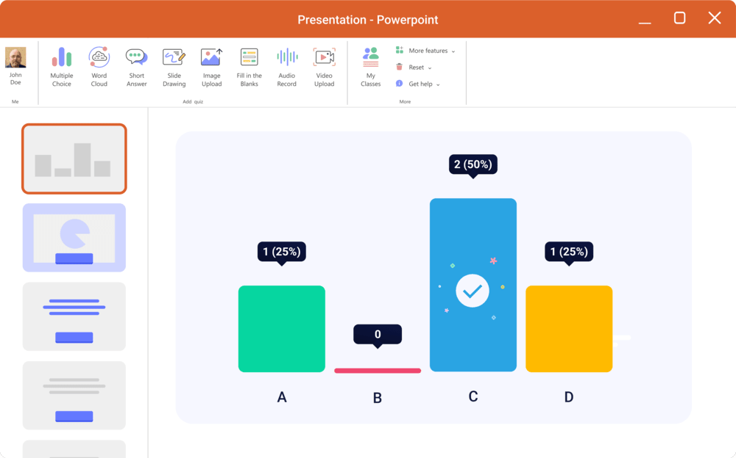

A whole new experience in PowerPoint
ClassPoint incorporates a comprehensive set of gamification, interactive quizzes, and presentation tools right inside PowerPoint
Gamified learning
Interactive quizzes
Presentation tools

Slide 24










1
1
Gamified Learning
A gamified reward system right inside your PowerPoint.
Award Stars to encourage class participation
Collect stars to level up and earn badges
Spark friendly competition with the Leader board

Slide 25








2
Interactive Quizzes
8 different types of interactive quiz questions:
Multiple Choice
Word Cloud
Short Answer
Slide Drawing
Image Upload
Fill in the Blanks
Audio Record
Video Upload

Slide 26
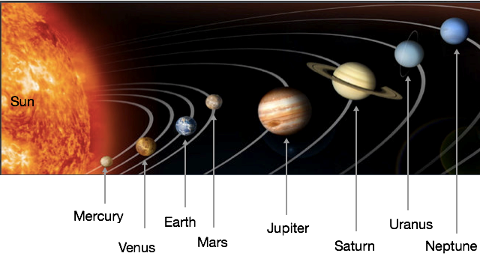


Sample Quiz: Multiple Choice
Which planet is known as the "Red Planet"?
A. Earth
B. Mars
C. Jupiter
D. Saturn
Click this button on slideshow mode!

Slide 27
2
Presentation Tools
In PowerPoint slide show mode, access our powerful presentation tools from the ClassPoint toolbar.
Draggable Objects
Name Picker
Pen
Eraser
Text box
Embedded browser
Cursor
Highlighter
Whiteboard
AI Quiz
Quick poll
Laser, spotlight
Navigation
Shapes
Timer
Leaderboard
Settings

Slide 28
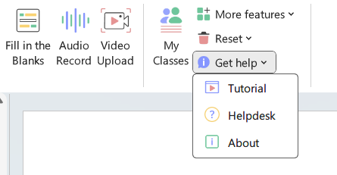






Still have questions?
1
Watch tutorial videos in the ClassPoint Tab
2
Contact us from the Helpdesk in the ClassPoint Tab
3
Email us at support@inknoe.com
Follow us on social media:

